Slide 1
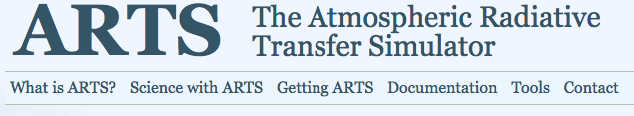
Introduction
Advanced Radiation and Remote Sensing
Winter Term 2016
Stefan Bühler
Meteorologisches Institut
Universität Hamburg

Slide 2
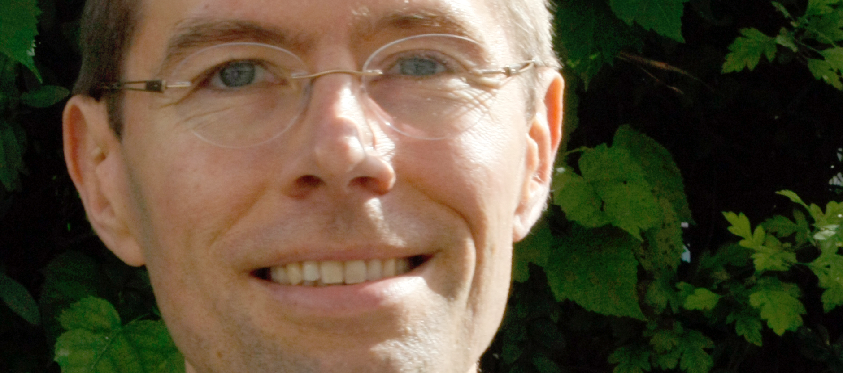
Contact
Stefan Bühler
Raum 1534 (Geomatikum)
Tel. +49 40 42838 8124
Email: stefan.buehler(at)uni-hamburg.de
Notes:
Seit 1 Monat in Hamburg.
Möchte gerne Bilder, um Namen lernen zu können

Slide 3
Modus operandi
Mixture of short lecture and a lot of practical exercises, all in the same place and time slot.
Examination: Short project towards the end of the course.
This course is experimental and meant to be rugged. Don’t expect any polish. Don’t even expect everything to work properly.

Slide 4
Main tool
Most (all?) exercises will somehow involve our own radiative transfer model: ARTS
After the course, you should be able to use ARTS and the tools around it for your own projects!

